Slide 1
生命科學一
Life Science I
授課老師：焦傳金、莊永仁 、黃貞祥
課程助教：張少銘、李宜庭、張詳林、王姍姍
國立清華大學 eeclass 數位學習平台
Slido課程代碼
＃114NTHULSICOURSE
期中考(10/16) 30%
期末考(12/18) 30%
每週心得(FB/IG) 30%
Slido提問 10%
學生使用AI規則：有條件開放，請註明如何使用生成式AI於課程產出

Slide 2
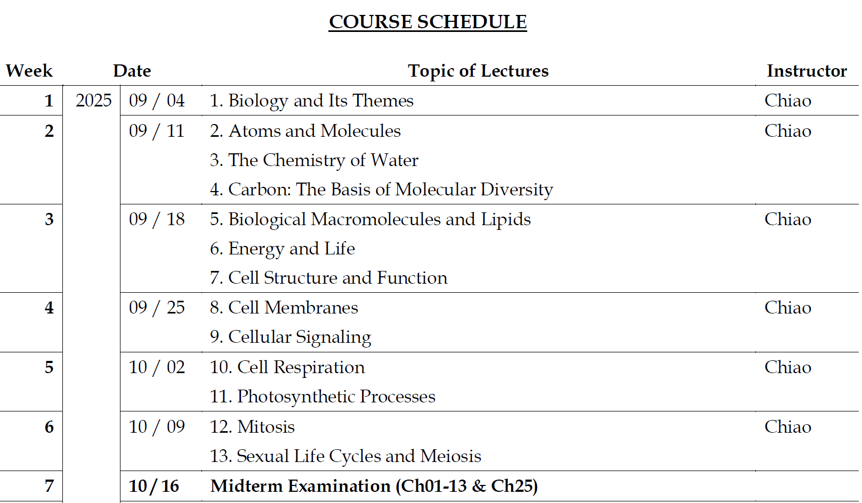

Slide 3
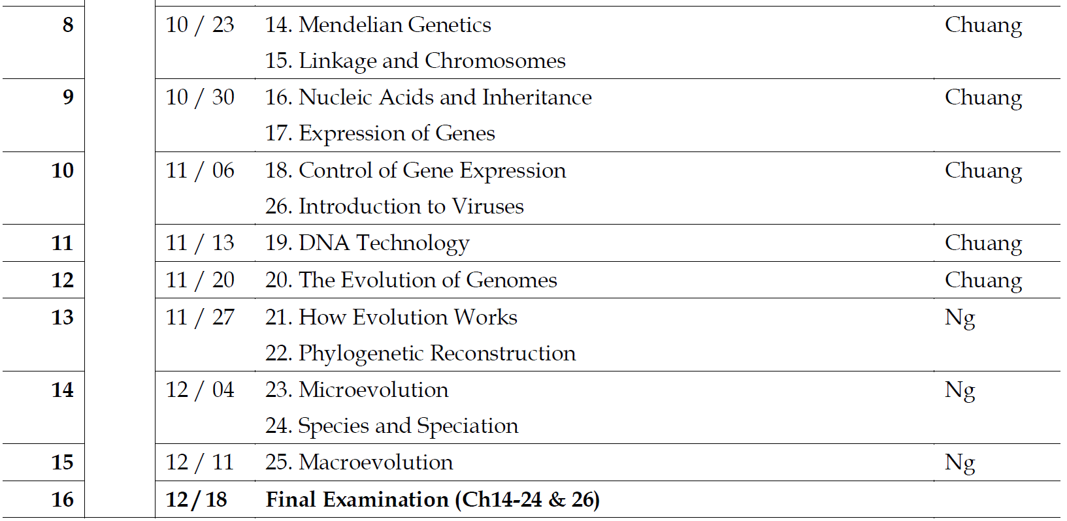

Slide 4
授課方式
課前
觀看課程影片（清華磨課師）
https://mooc.nthu.edu.tw/course/info/360
課中（Thur., 15:30~17:00）
第一堂課：最新研究分享或課程補充＋課堂提問（Slido）
第二堂課：問題解答與討論（30分鐘）
課後
在FB/IG撰寫課堂心得（600字以上、＃生命科學一）
全部心得公開分享：加學期總分2分
學生使用 AI 規則：有條件開放，請註明如何使用生成式AI於課程產出

Slide 5
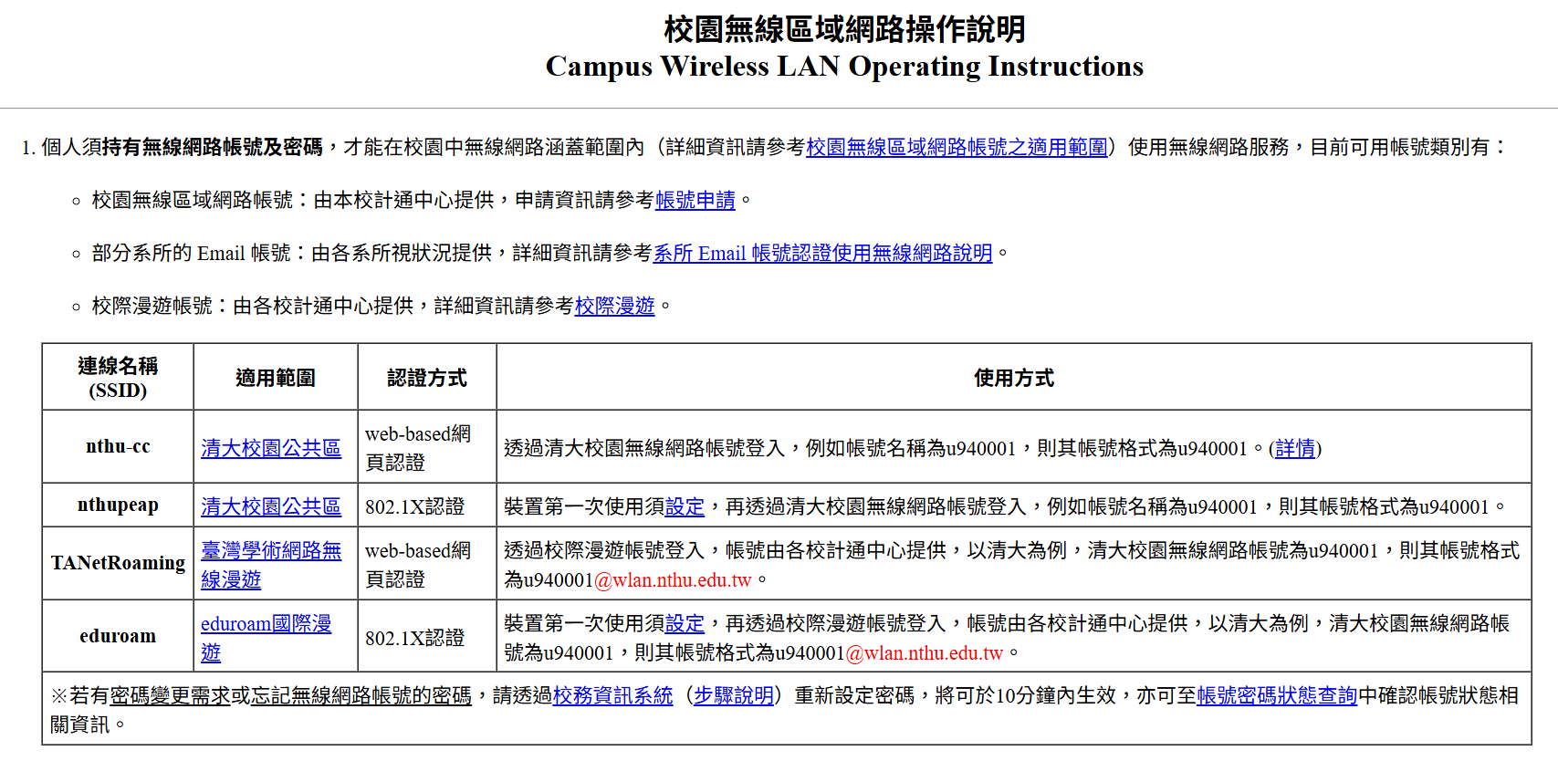
點名
上課時間為每週四15:30~17:00。每週都會點名，若點名未到，則該週心得不計分。
由於華生廳網路收訊不佳，請同學先申請校園無線區域網路。

Slide 6
心得作業
每週課程結束後，需上傳600字課程心得，於下週上課時間前繳交。
在自己的FB或IG上傳心得可加分。發文需附上一張課程圖片或影片並標記 #生命科學一，完成後截圖上傳至eeclass作業區。
未標記課程、截圖不完整、字數過少或過多會視情況扣分。抄襲、遲交、發在限時動態都不計分。
全部心得公開分享：加學期總分2分

Slide 7
心得作業評分標準
心得內容延伸想法、查詢資料並附上來源 – 3分
心得內容與課程相關，且600字以上 – 2分或1分
心得與課程完全無關，或不足600字 – 0分

Slide 8
Slido提問
每週亦須於上課結束時間前完成Slido之課堂提問
請勿使用匿名發問，匿名發問者，將不計分
發言內容涉及暴力、歧視或性騷擾等不當言論，且屢勸不聽者，將送交本校學生獎懲委員會或性別平等教育委員會處理。

Slide 9
Slido提問評分標準
與當週課程內容高度相關– 10分
與當週課程內容不完全相關但包含生命科學學科相關– 6分
與課程內容完全無關或未提問– 0分

Slide 10
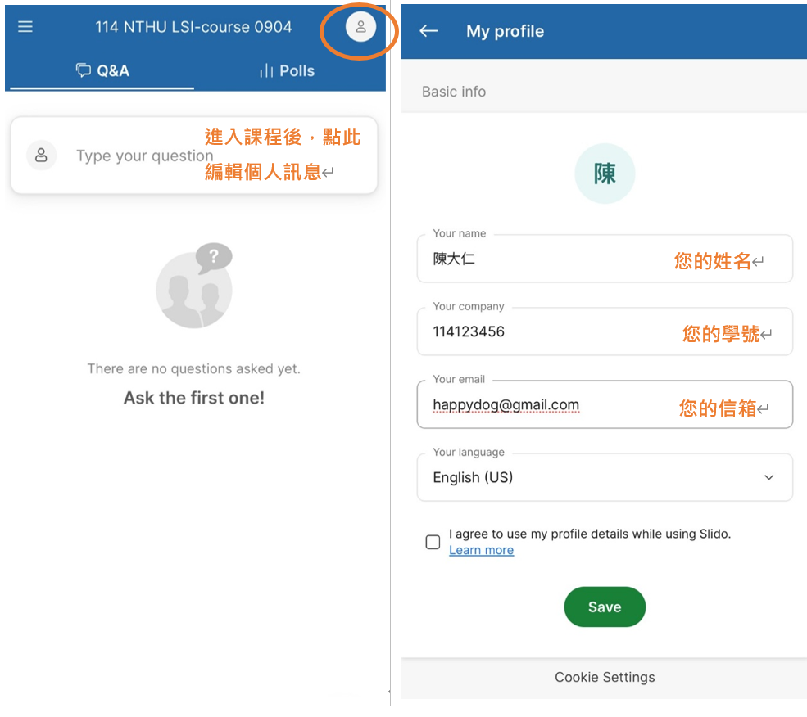

Slide 11
期中與期末考大抄
期中考及期末考開放攜帶一張紙本A4雙面本人手寫之大抄，不得影印、黏貼、打字輸出，同學們可以提早進行準備。

Slide 12
成績計算方式
期中考 30%
期末考 30%
每週心得 30%
Slido提問 10%

Slide 13
請假方法
如需請假，請根據國立清華大學學生請假辦法，於校務資訊系統的學生請假系統請假。

Slide 14
助教聯繫方式
助教的信箱會放在eeclass公告中。
如需寄信給助教，麻煩同學們同時寄發給所有助教，並且告知課程、姓名、學號，以免有任何漏信的可能性發生。

Slide 15
Any question?

Slide 16
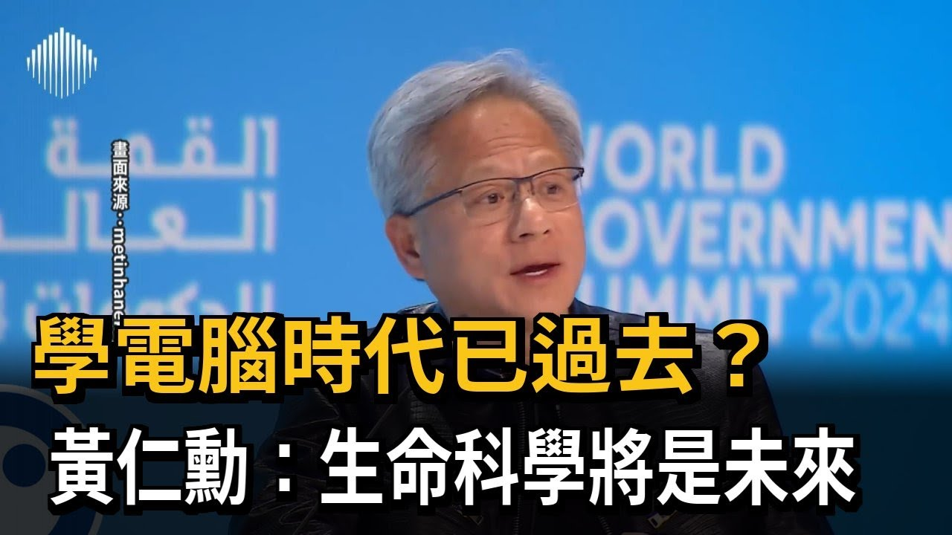

Slide 17



Do not edit How to change the design
你認同黃仁勳講的話嗎？
The Slido app must be installed on every computer you’re presenting from

Slide 18

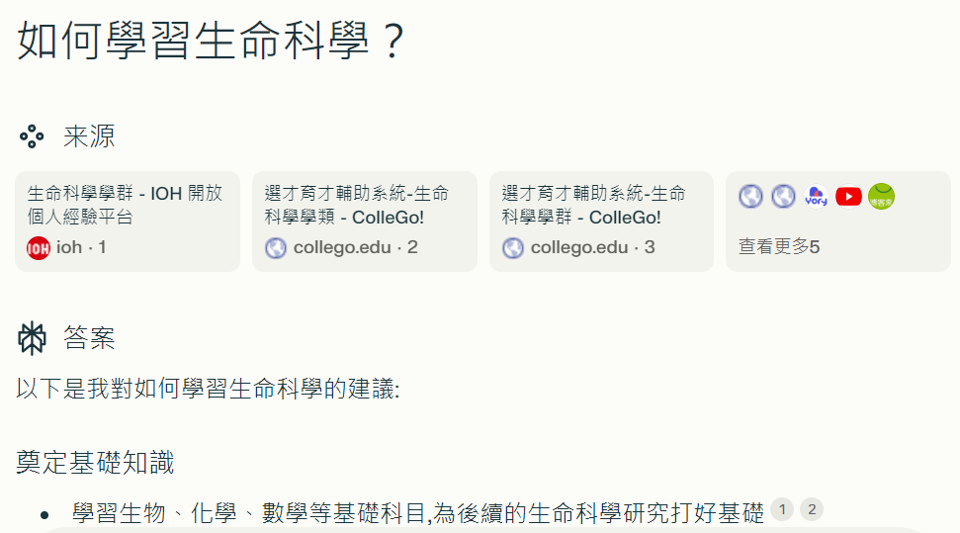
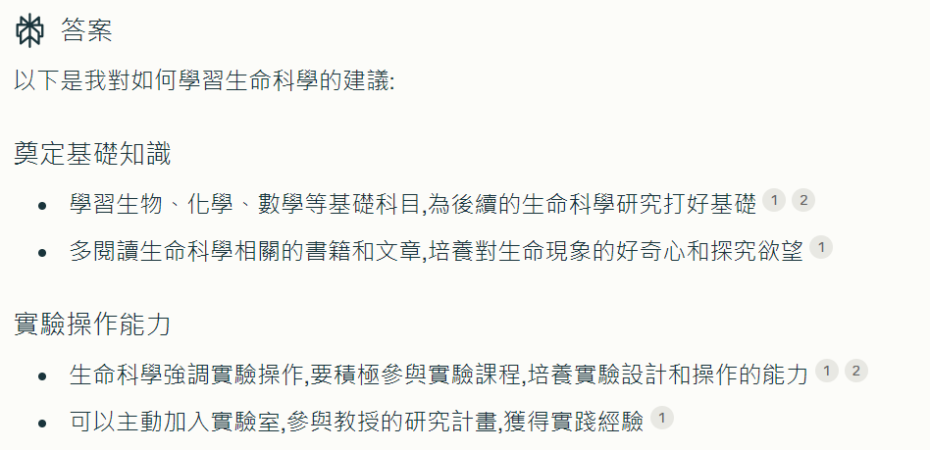

Slide 19
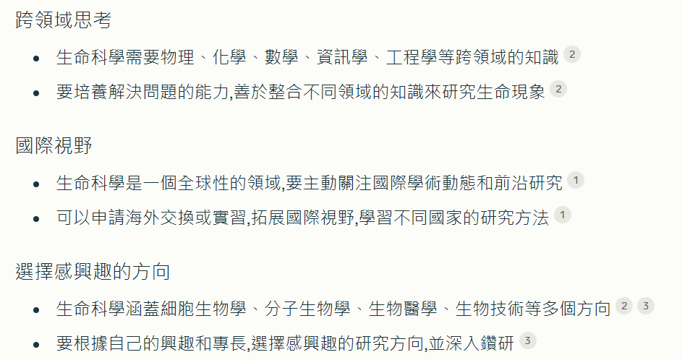
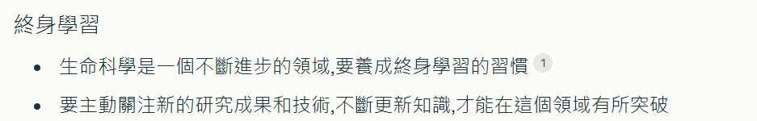

Slide 20
Biology for everyday life

Slide 21



Slide 22
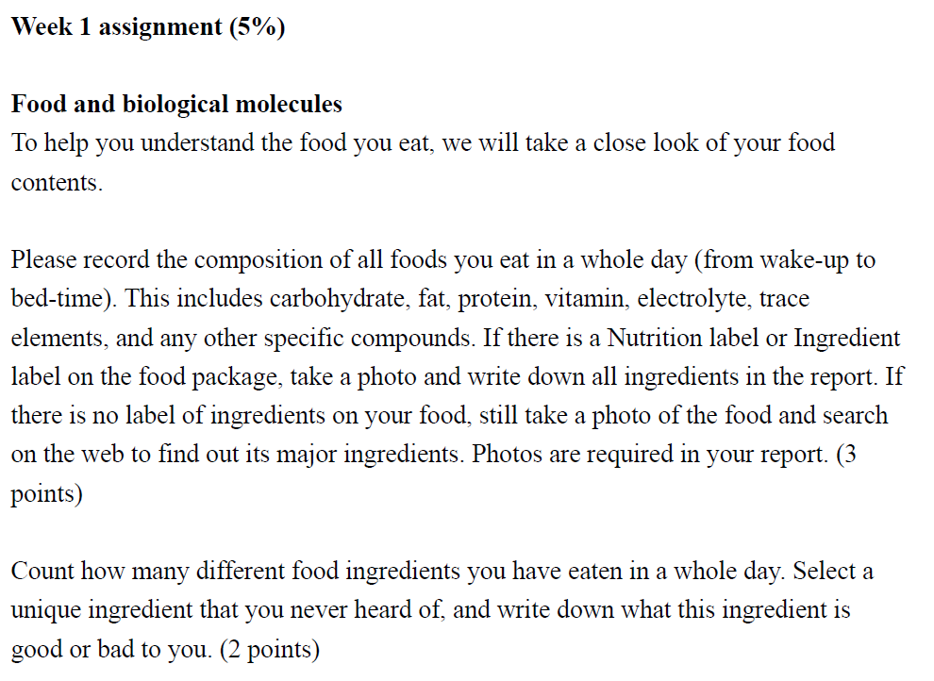

Slide 23
Notes:
23

Slide 24

Do not edit How to change the design
對這門課的期待
The Slido app must be installed on every computer you’re presenting from

Slide 25
CONCEPT 1.1: The study of life reveals unifying themes
There are five unifying themes in Biology
Organization
Information
Energy and Matter
Interactions
Evolution (core theme)

Slide 26
Theme: New Properties Emerge at Successive Levels of Biological Organization
Life can be studied at different levels, from molecules to the entire living planet
Reductionism is an approach that reduces complex systems to simple components that are manageable to study
Emergent properties result from the arrangement and interaction of parts as complexity increases
To explore emergent properties, biologists complement reductionism with systems biology, analysis of the interactions among the parts of a biological system

Slide 27
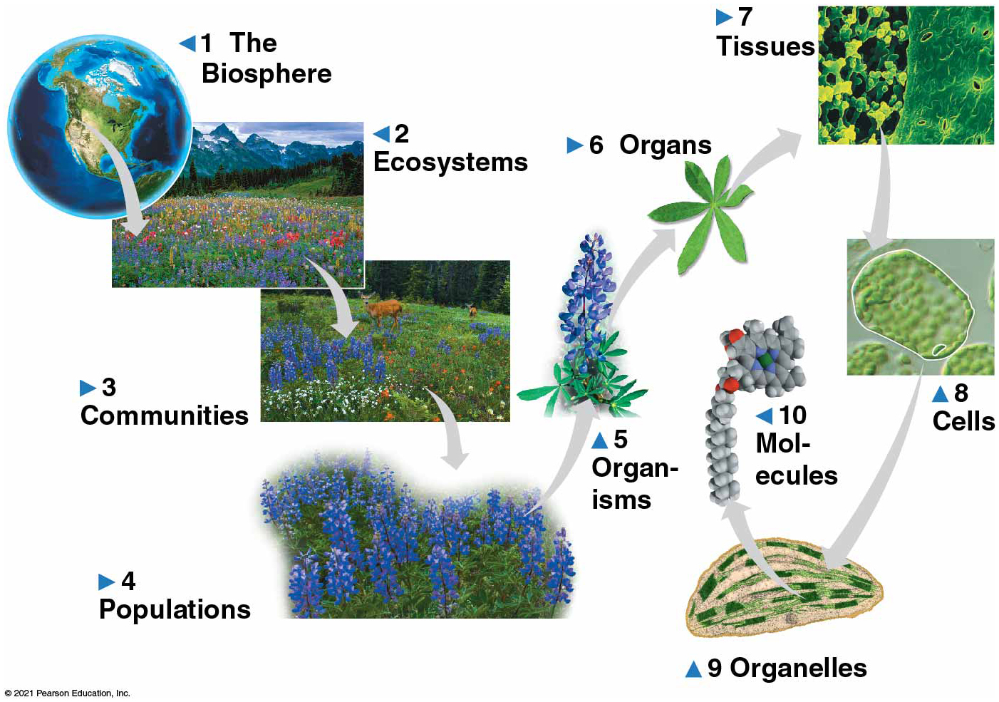
Figure 1.3
Exploring levels of biological organization
Notes:
Figure 1.3 Exploring levels of biological organization

Slide 28
Do not edit How to change the design
Which level of biological organization that you would like to study in the future?
The Slido app must be installed on every computer you’re presenting from

Slide 29
Theme: Life’s Processes Involve the Expression and Transmission of Genetic Information
Within cells, structures called chromosomes contain genetic material in the form of DNA (deoxyribonucleic acid)
DNA is transcribed into RNA, which is then translated into a protein
Gene expression is the process of converting information from gene to cellular product

Slide 30
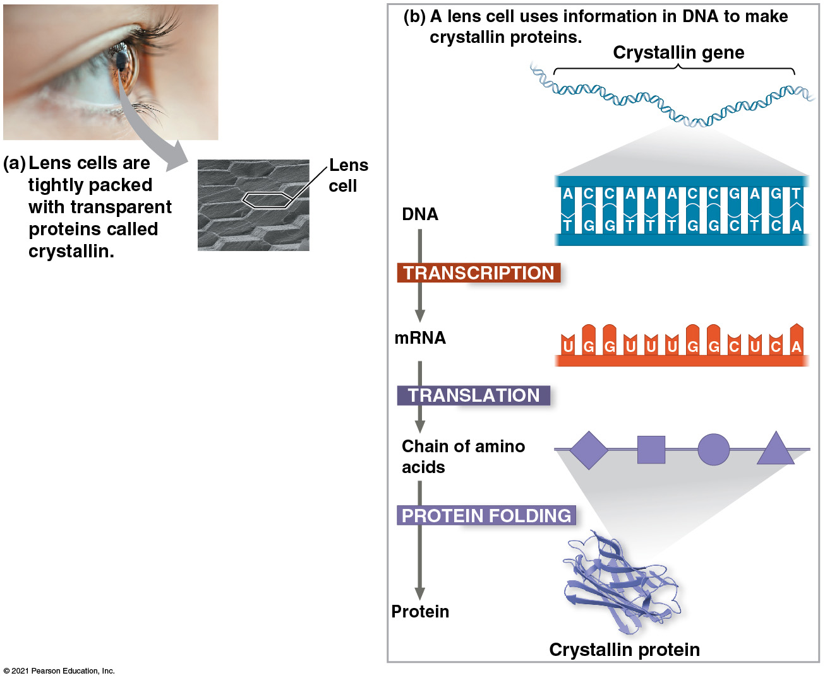
Figure 1.8
Notes:
Figure 1.8 Gene expression: cells use information encoded in a gene to synthesize a functional protein

Slide 31
Theme: Life Requires the Transfer and Transformation of Energy and Matter
The input of energy from the sun and the transformation of energy from one form to another make life possible
The chemical energy generated by plants and other photosynthetic organisms (producers) is passed along to consumers
Consumers are organisms that feed on other organisms or their remains

Slide 32
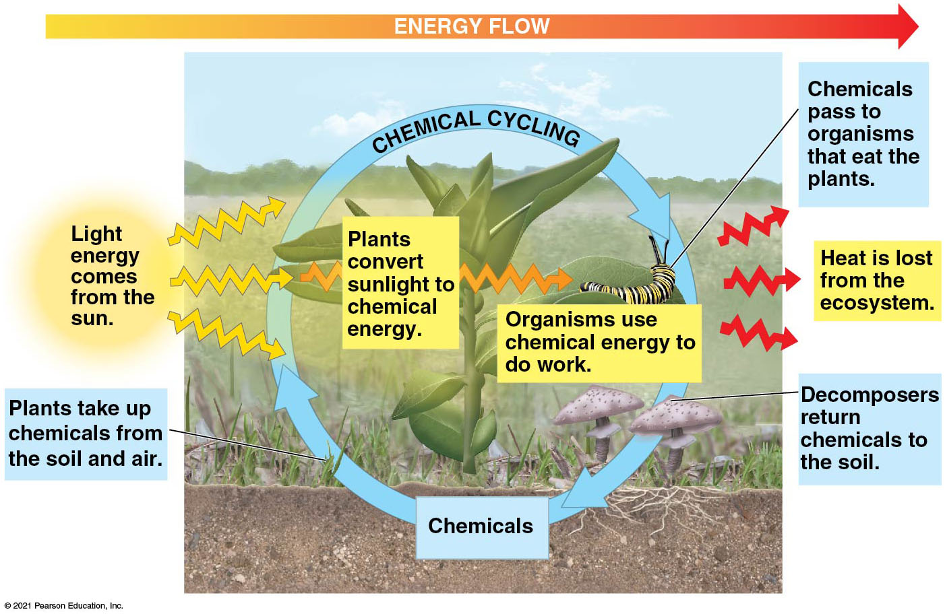
Figure 1.9
Energy flow and chemical cycling
Notes:
Figure 1.9 Energy flow and chemical cycling

Slide 33
Theme: From Molecules to Ecosystems, Interactions Are Important in Biological Systems
Interactions between the components of the system ensure smooth integration of all the parts
This holds true equally well for molecules in a cell and the components of an ecosystem

Slide 34
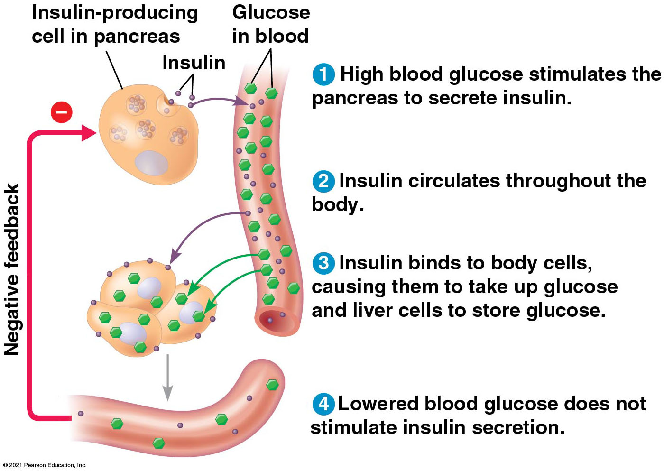
Figure 1.10
Feedback regulation
Notes:
Figure 1.10 Feedback regulation

Slide 35
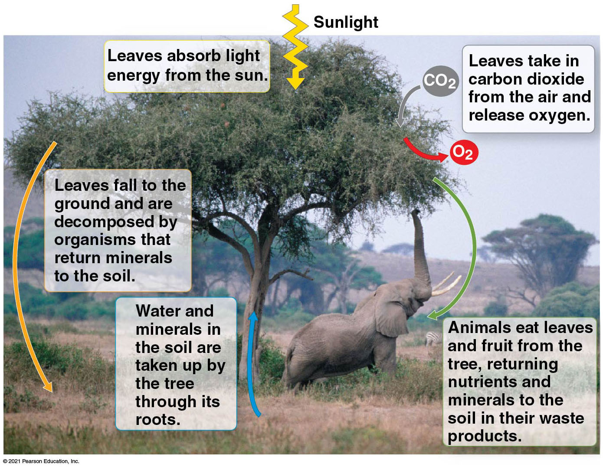
Figure 1.11
Notes:
Figure 1.11 Interactions of an African acacia tree with other organisms and the physical environment

Slide 36
CONCEPT 1.2: The Core Theme: Evolution accounts for the unity and diversity of life
An understanding of evolution helps us to make sense of everything we know about life on earth
The scientific explanation for both the unity and diversity of organisms is evolution, the concept that living organisms are modified descendants of common ancestors
“Nothing in biology makes sense except in the light of evolution”—Theodosius Dobzhansky

Slide 37
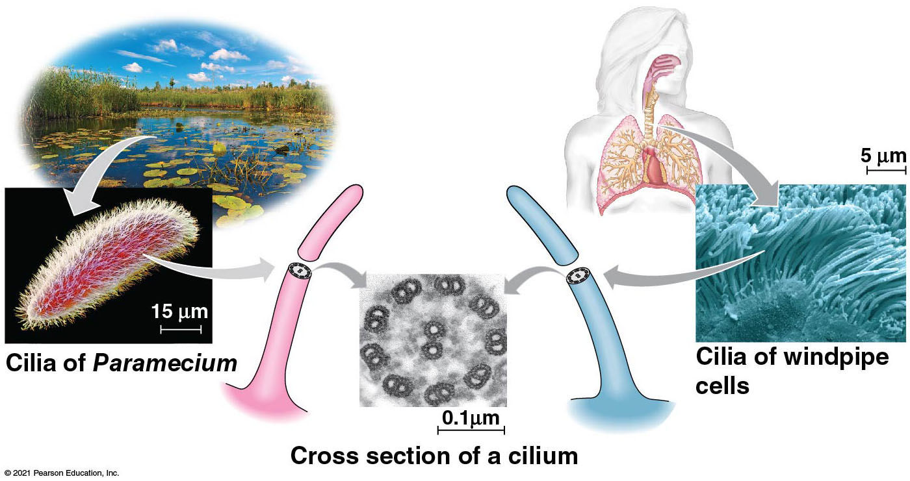
Figure 1.14
An example of unity underlying the diversity of life: the architecture of cilia in eukaryotes
Notes:
Figure 1.14 An example of unity underlying the diversity of life: the architecture of cilia in eukaryotes

Slide 38
Charles Darwin and the Theory of Natural Selection
Charles Darwin published On the Origin of Species by Means of Natural Selection in 1859
Darwin made two main points
Species showed evidence of “descent with modification” from common ancestors
“Natural selection” is the mechanism behind descent with modification
Darwin’s theory explained the duality of unity and diversity

Slide 39
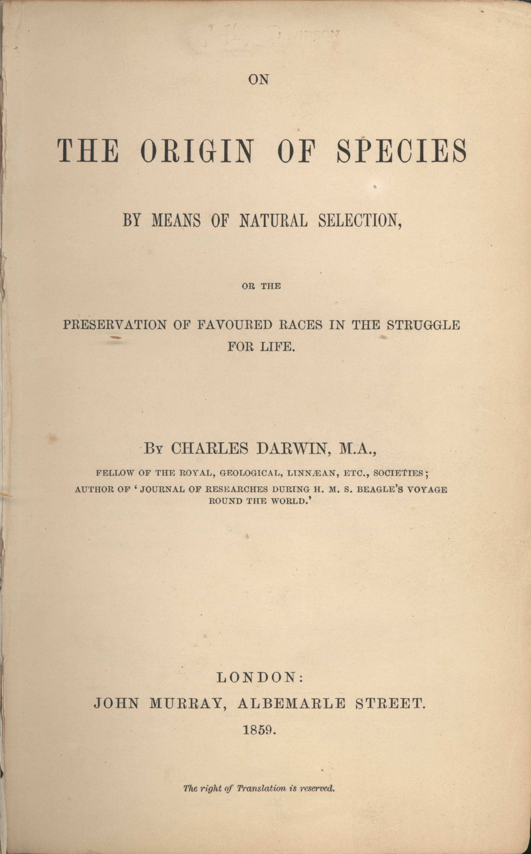
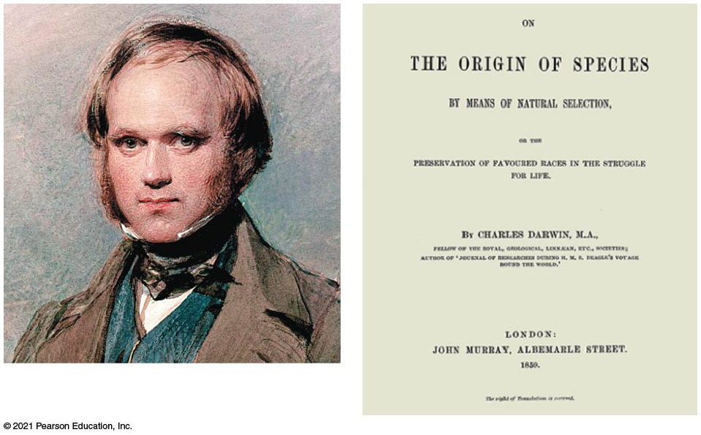
Figure 1.16
Notes:
Figure 1.16 Charles Darwin

Slide 40
CONCEPT 1.3: In studying nature, scientists form and test hypotheses
The word science is derived from Latin and means “to know”
Inquiry is the search for information and explanations of natural phenomena
Scientists use a process of inquiry that includes making observations, forming logical hypotheses, and testing them

Slide 41
Forming and Testing Hypotheses
In science, a hypothesis is an explanation, based on observations and assumptions, that leads to a testable prediction
It must lead to predictions that can be tested by making additional observations or by performing experiments
An experiment is a scientific test, carried out under controlled conditions

Slide 42
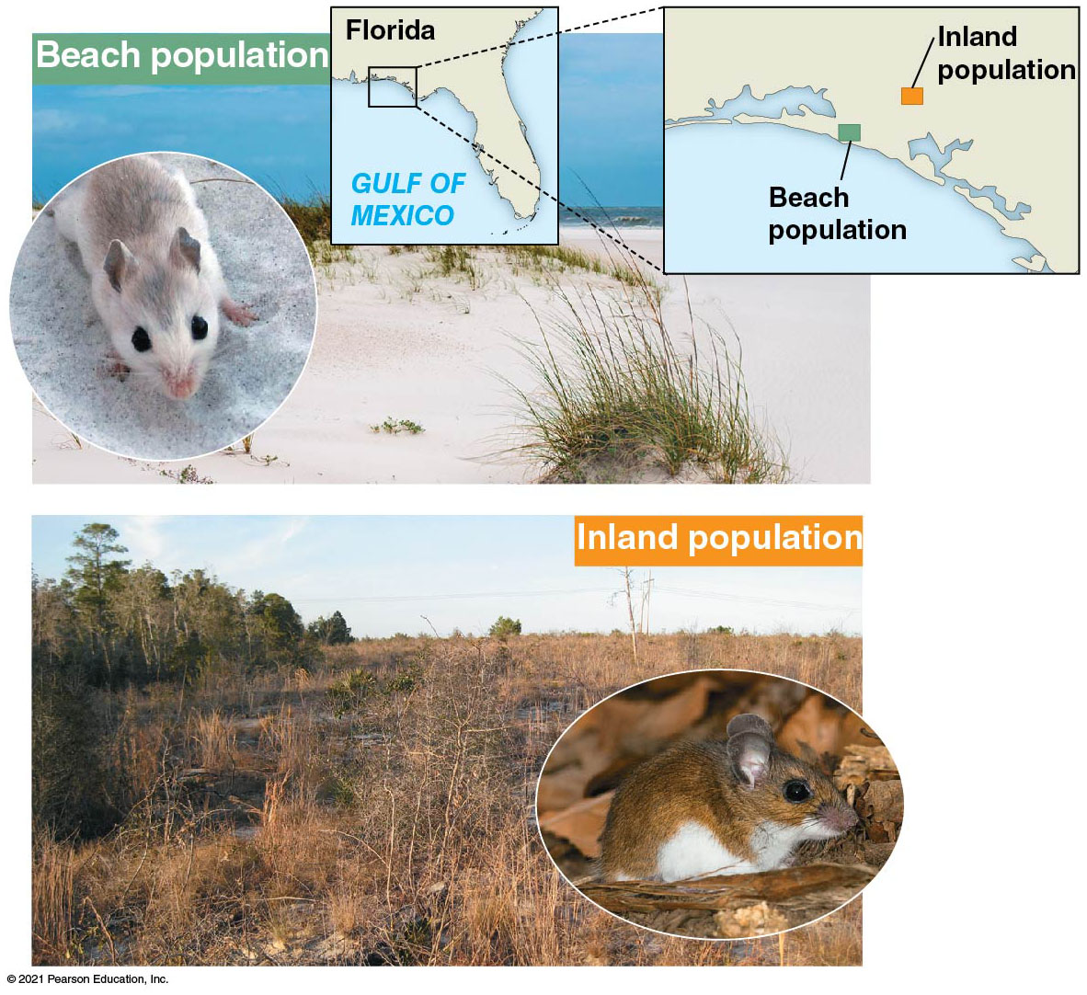
A Case Study in Scientific Inquiry: Investigating Coat Coloration in Mouse Populations
Different coloration in beach and inland populations of Peromyscus polionotus

Slide 43
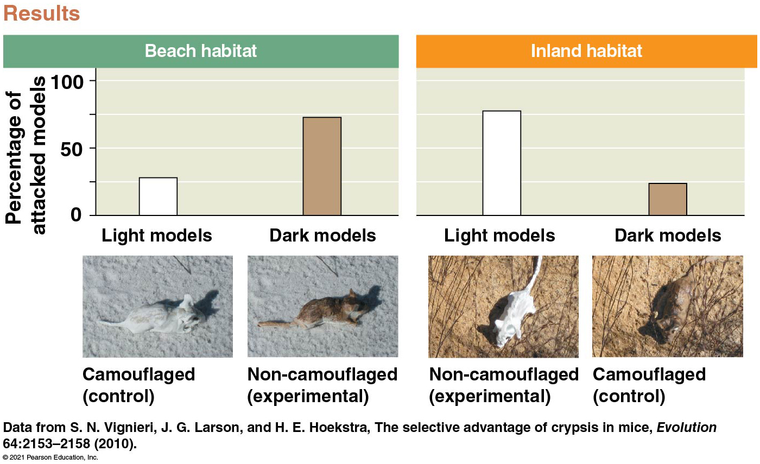
Figure 1.25
Camouflage affects predation rates on two populations of mice
Notes:
Figure 1.25 Inquiry: Does camouflage affect predation rates on two populations of mice?

Slide 44
CONCEPT 1.4: Science benefits from a cooperative approach and diverse viewpoints
Most scientists work in teams, which often include graduate and undergraduate students
Good communication is important in order to share results through seminars, publications, and websites
Research papers are not published until vetted by colleagues in the “peer review” process

Slide 45
What is life?

Slide 46

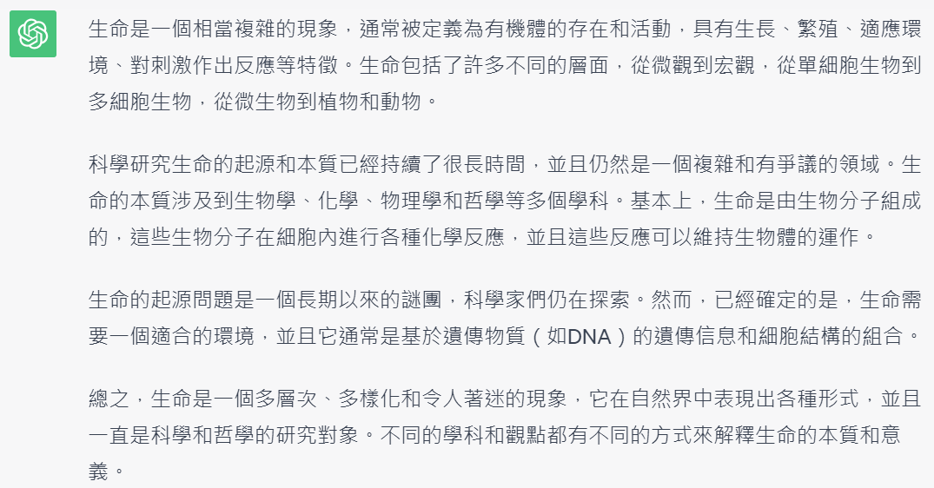

Slide 47
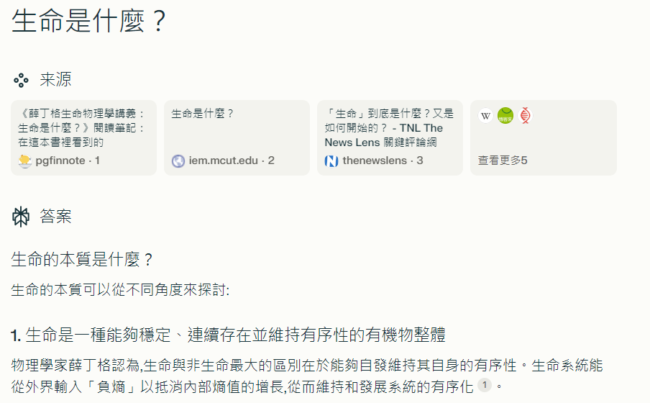
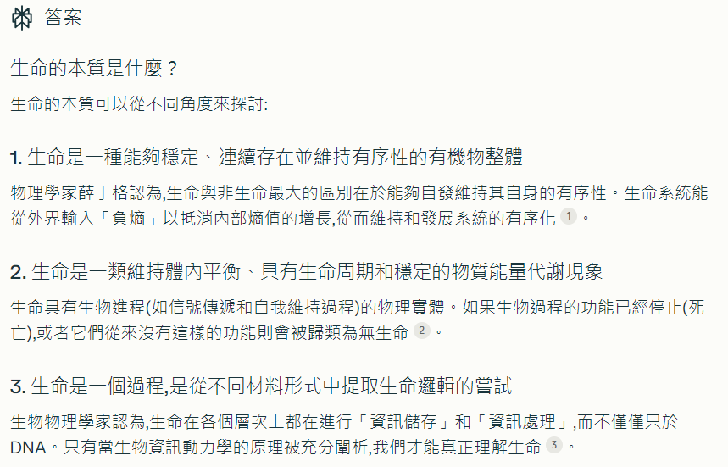

Slide 48
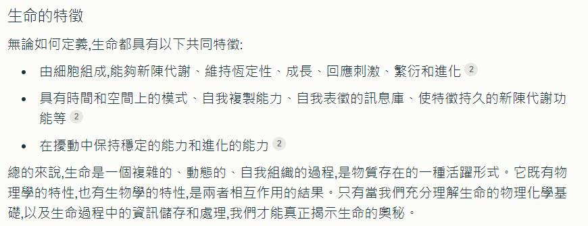

Slide 49
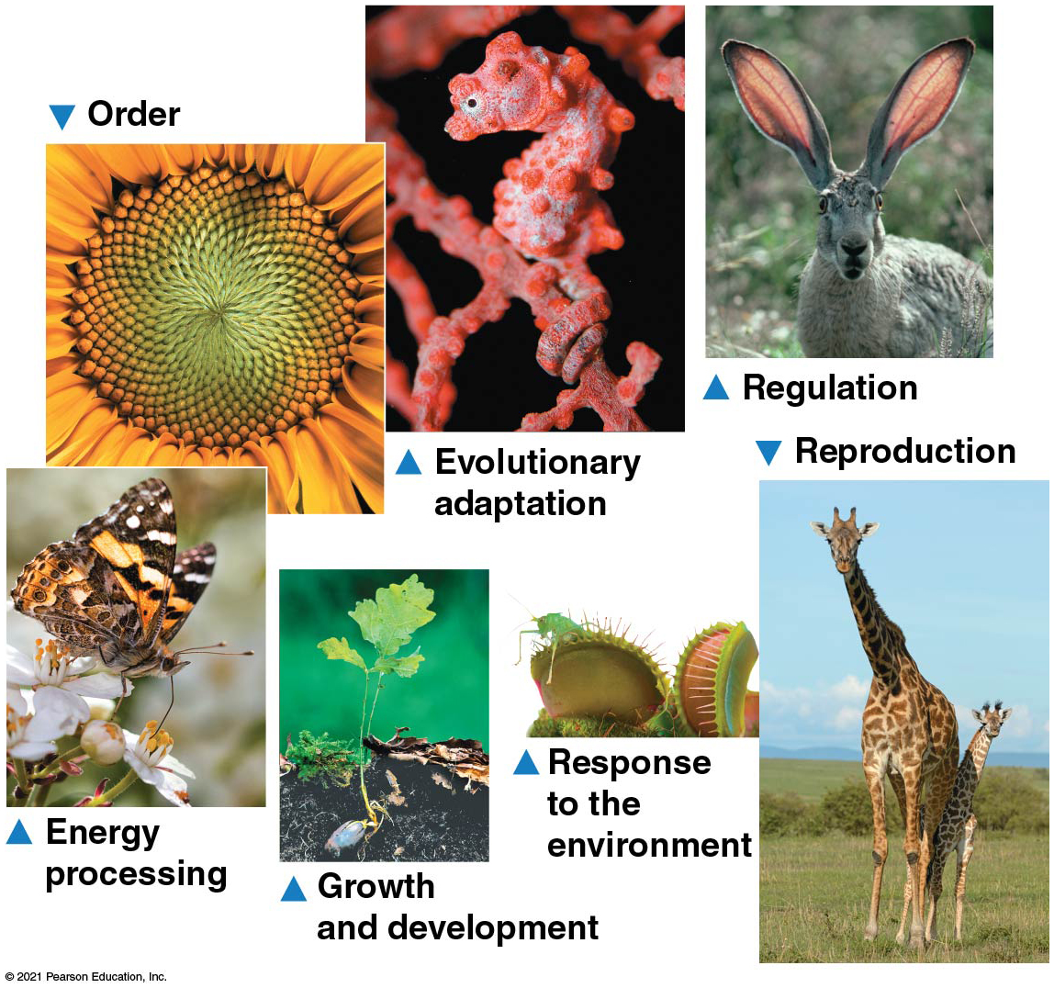
Figure 1.2
Some properties of life
Notes:
Figure 1.2 Some properties of life

Slide 50

Do not edit How to change the design
你認為生命的最大特徵是什麼？請用2個中文字回答
The Slido app must be installed on every computer you’re presenting from

Slide 51
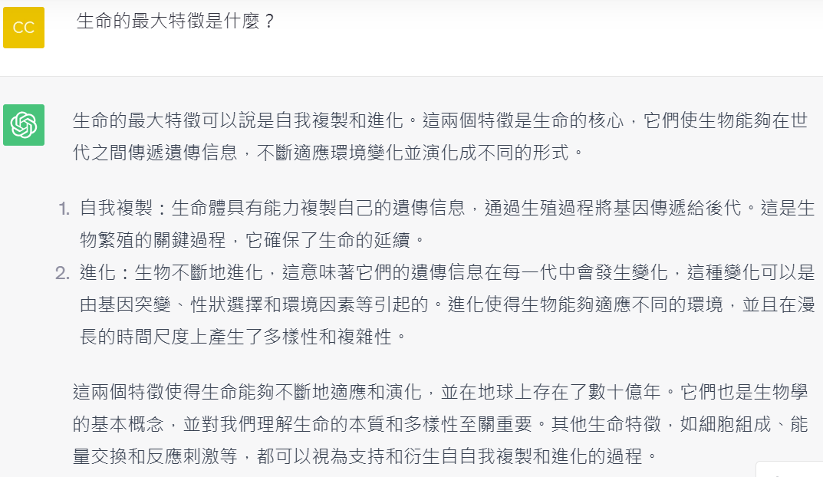

Slide 52
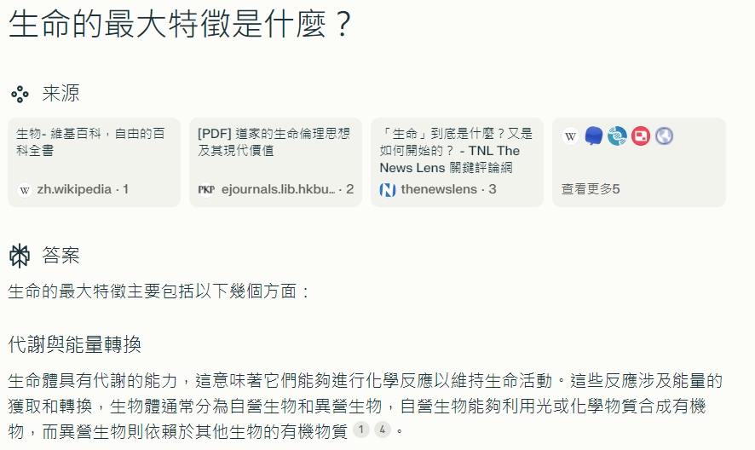
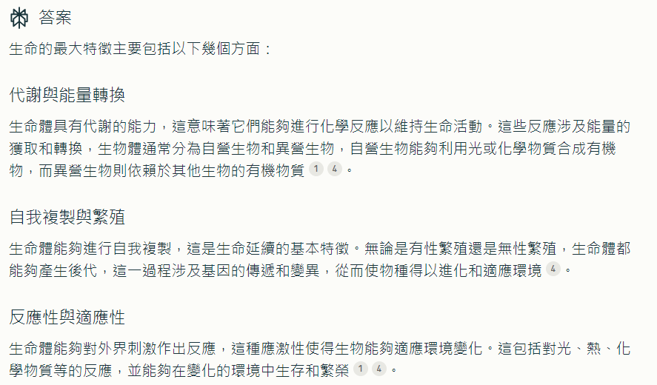

Slide 53
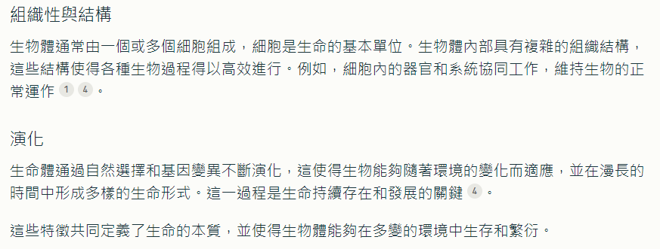

Slide 54
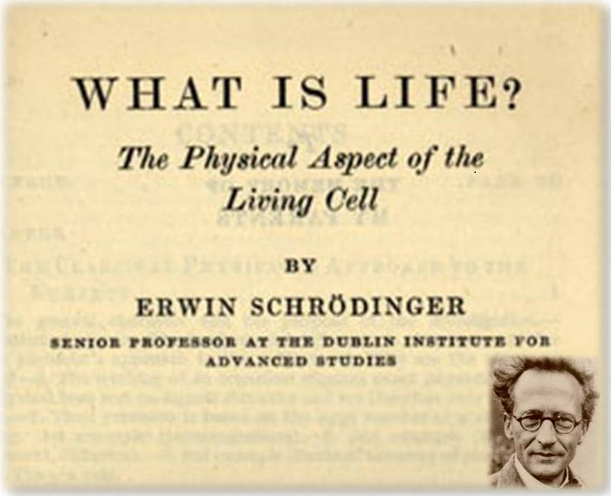
1944

Slide 55
In chapter I, Schrödinger explains that most physical laws on a large scale are due to chaos on a small scale. He calls this principle “order-from-disorder. He explains that living matter evades the decay to thermodynamical equilibrium by homeostatically maintaining negative entropy in an open system.
In chapter II and III, he summarizes what was known at this time about the hereditary mechanism.
Schrödinger believes the heredity material to be a molecule, which unlike a crystal does not repeat itself. He calls this an aperiodic crystal. Its aperiodic nature allows it to encode an almost infinite number of possibilities with a small number of atoms.
from Wikipedia

Slide 56
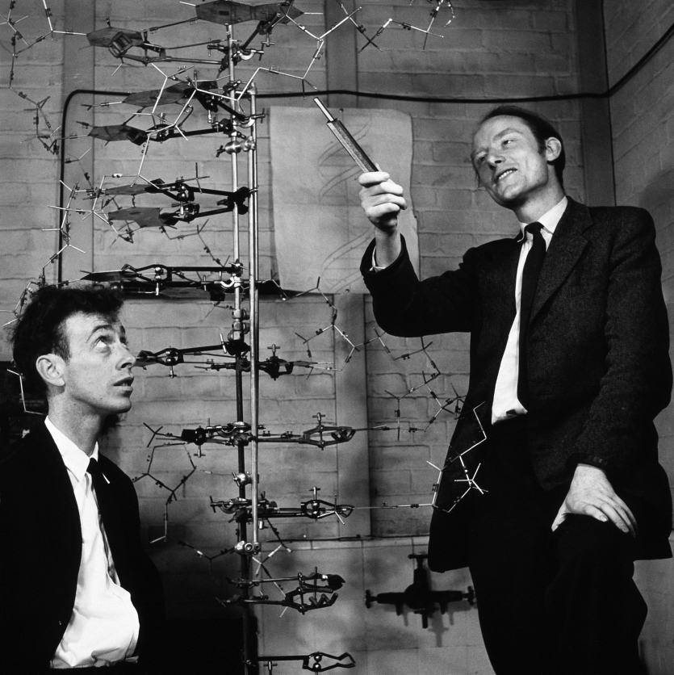
Cavendish Laboratory, University of Cambridge, 1953

Slide 57
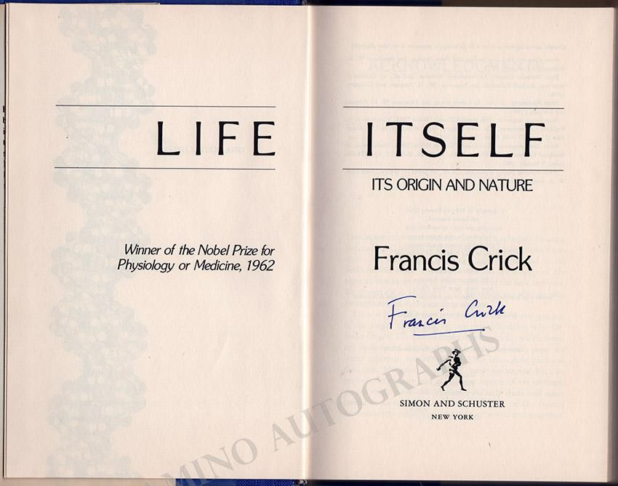
1981

Slide 58
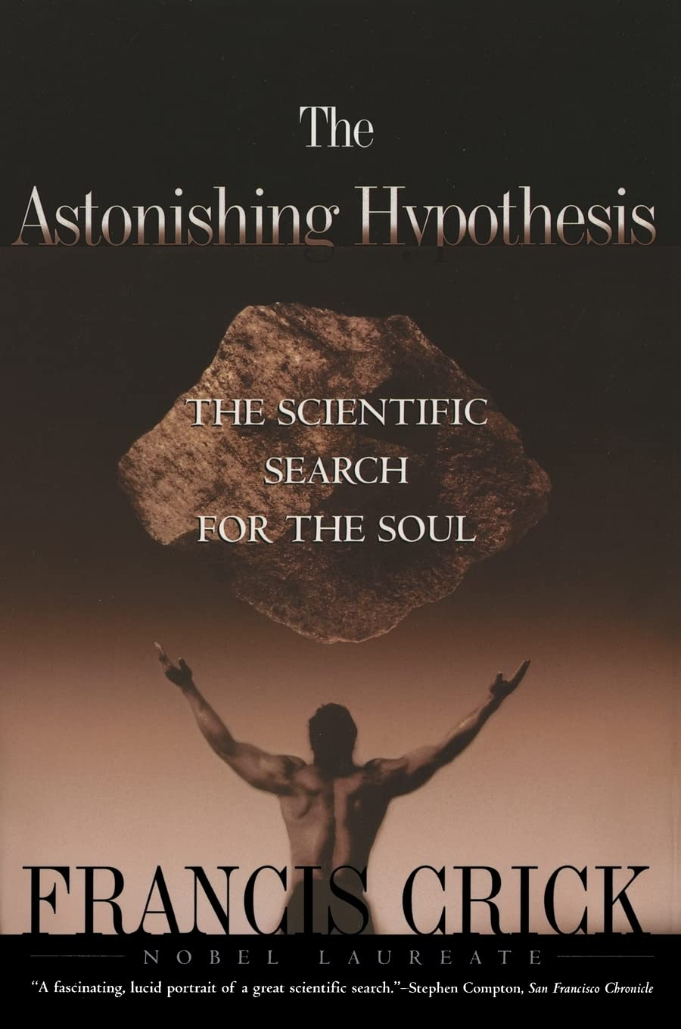
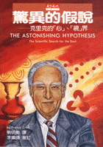
驚異的假說：克里克的「心」、「視」界
The Astonishing Hypothesis
1997
(July 1, 1995)

Slide 59
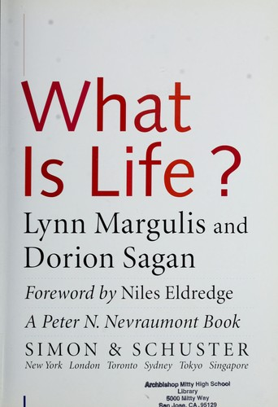
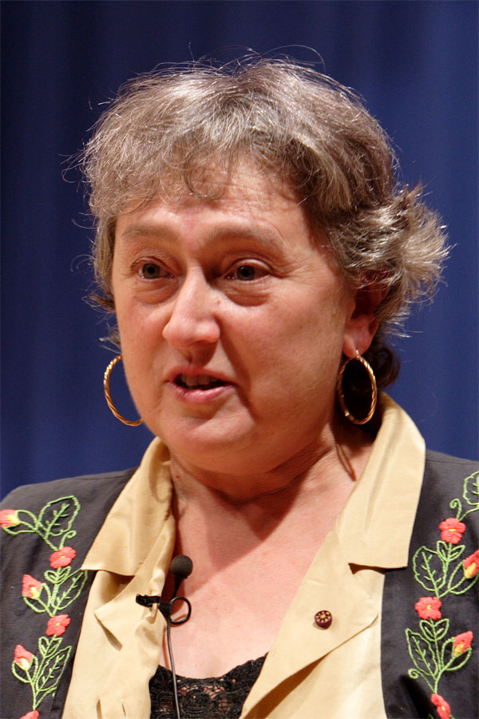
1995

Slide 60
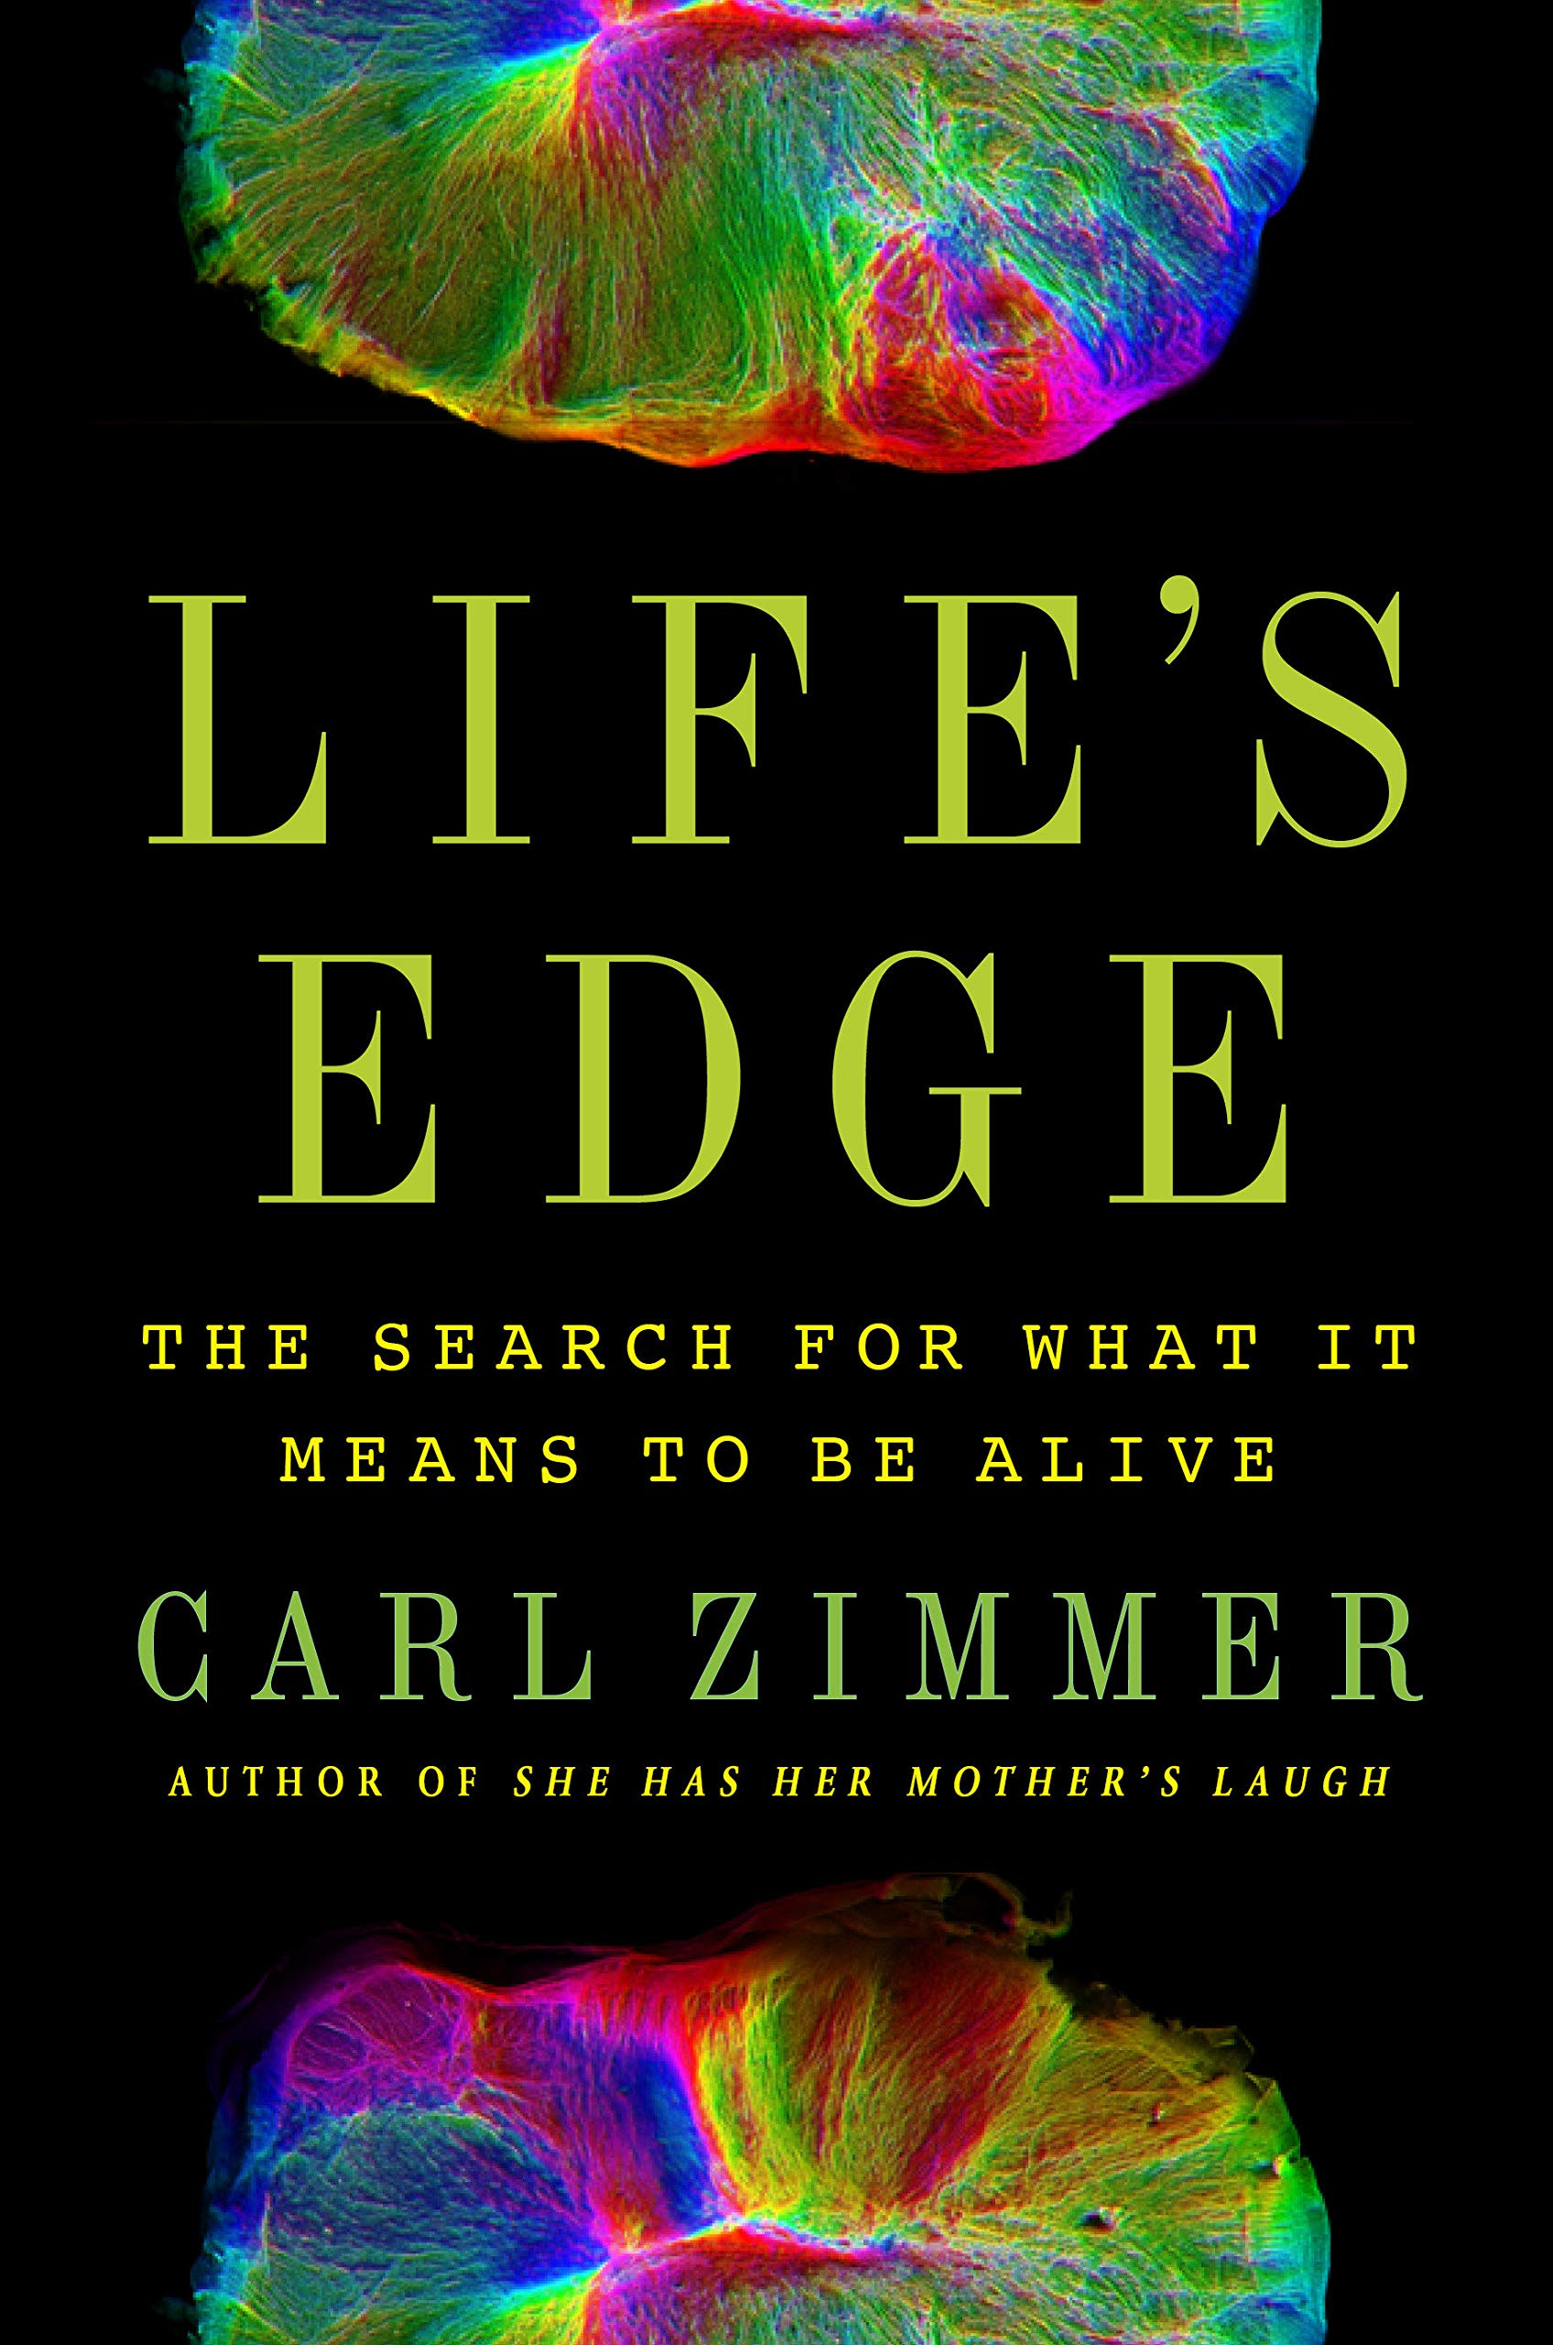
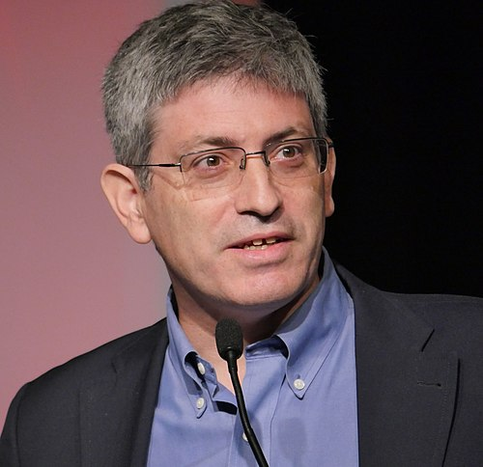
2021

Slide 61
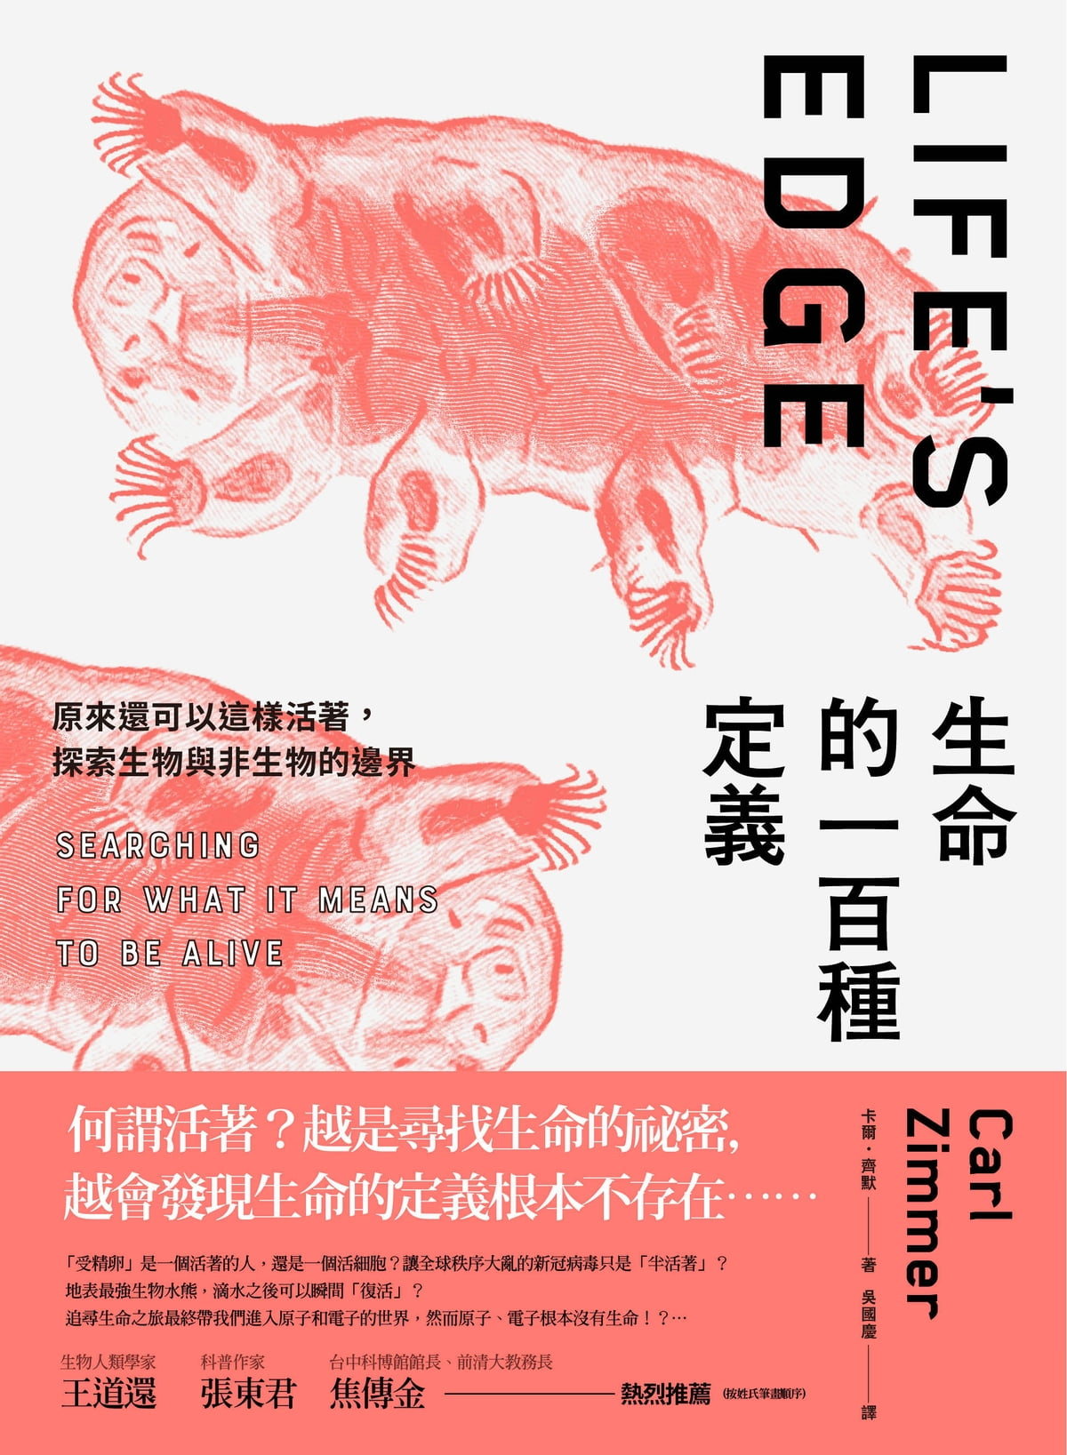
2021

Slide 62

The NASA definition of life
Life is a self-sustaining chemical system capable of Darwinian evolution (1992)

Slide 63
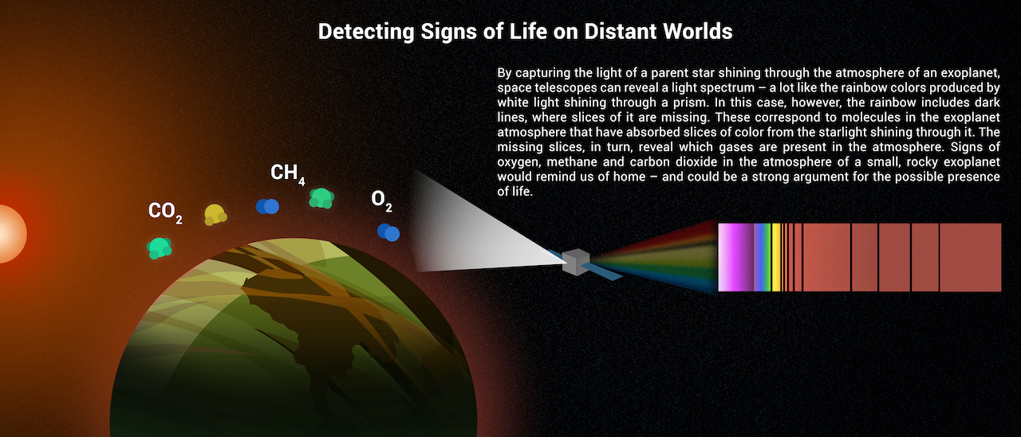

Slide 65
半活著

Slide 66
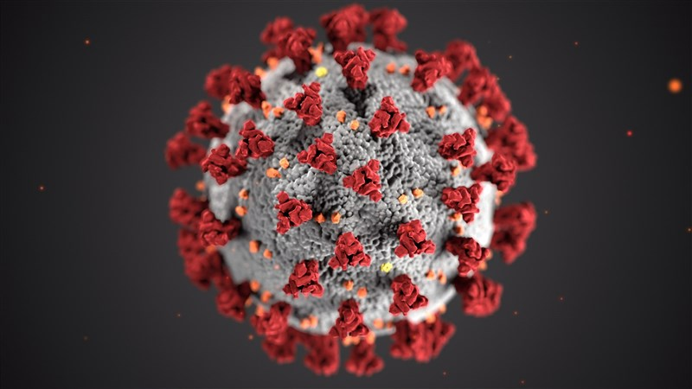
COVID-19

Slide 67
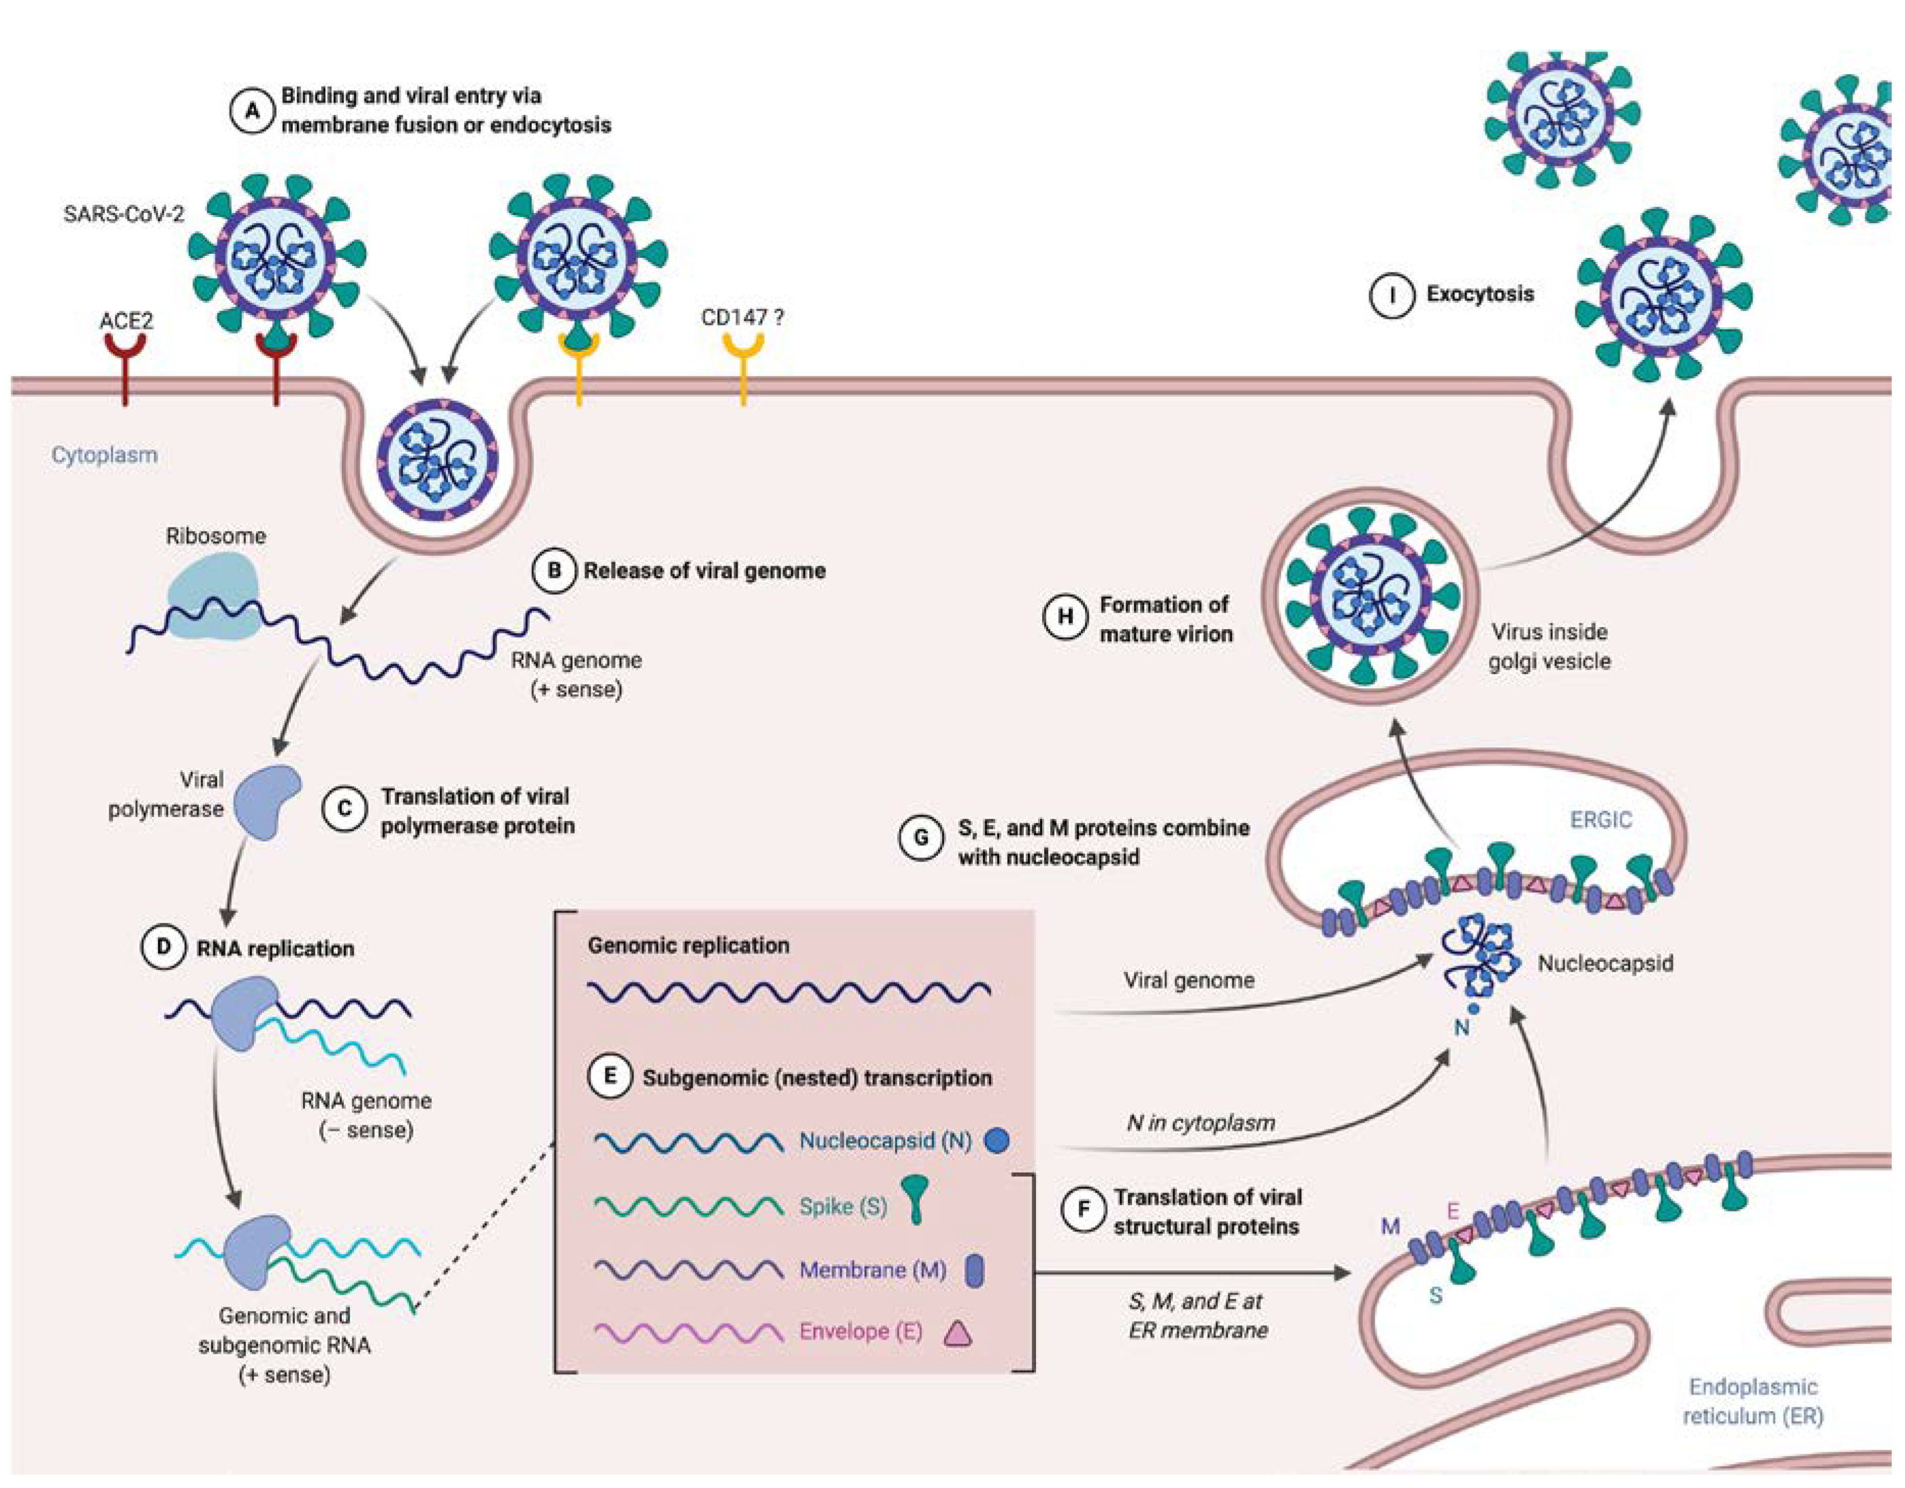

Slide 68
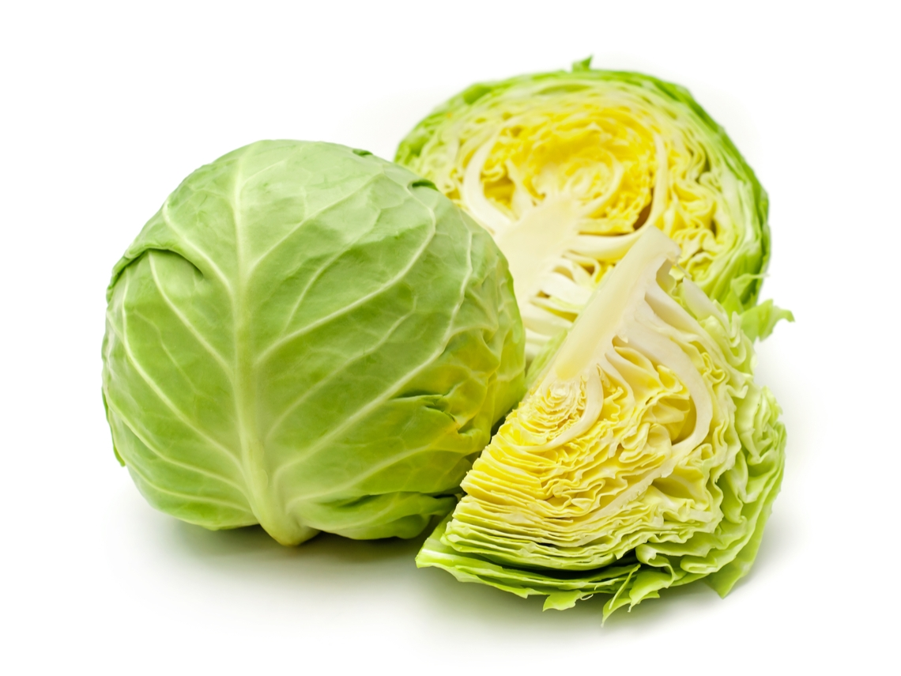
Cabbages

Slide 69
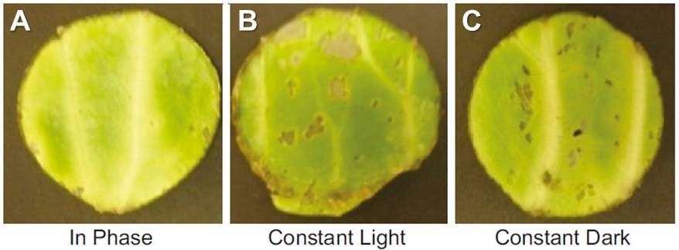
Circadian rhythms help protect produce from herbivores. Samples from cabbages kept in (A) cyclic “in phase” light, (B) constant light, or (C) constant dark conditions were fed to larvae. Cabbages kept in constant light or constant dark sustained the most damage.
Current Biology 2013

Slide 70
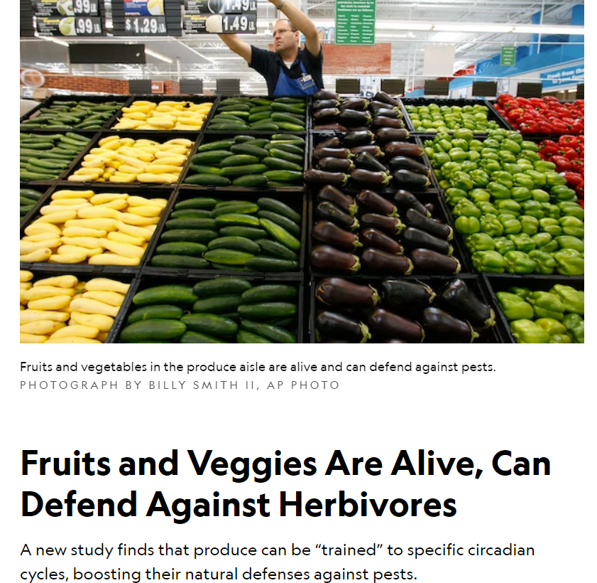

Slide 71
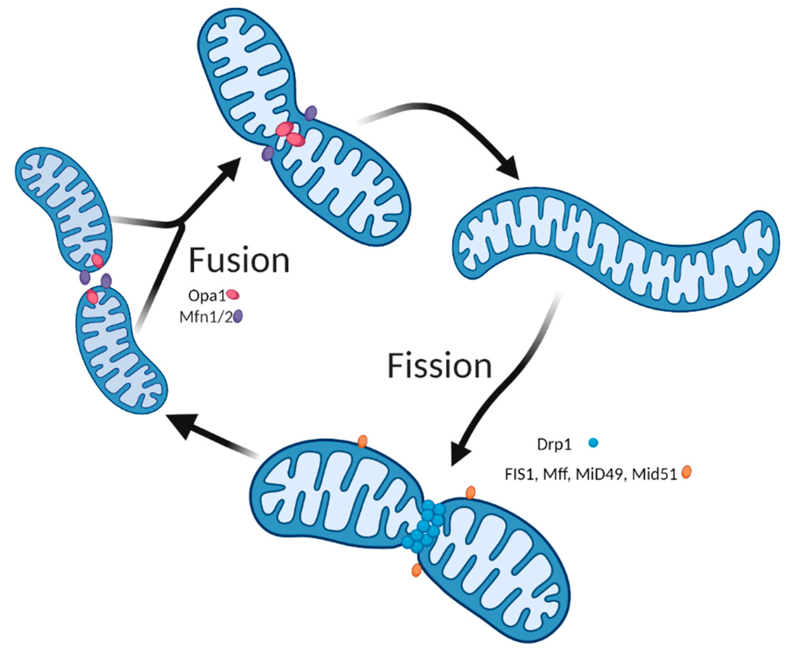
Mitochondria

Slide 72
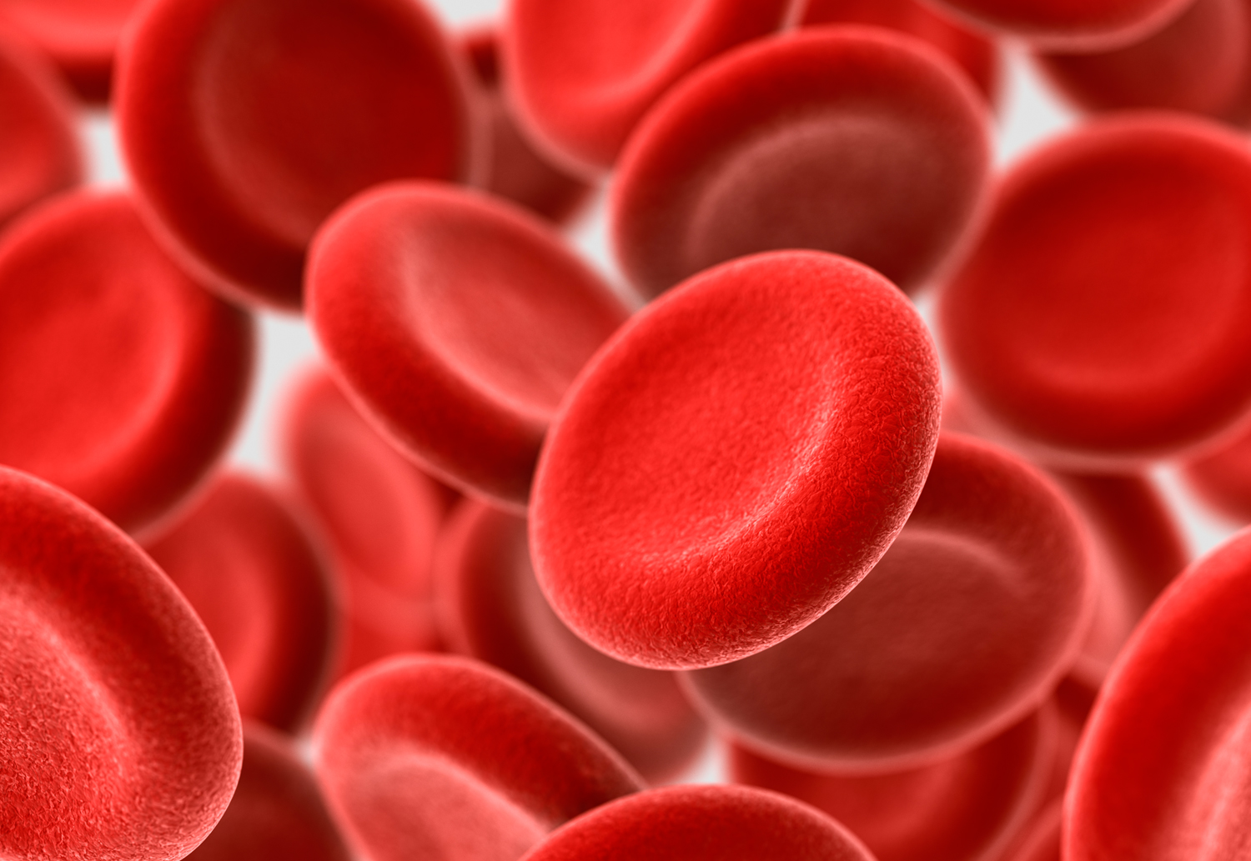
Red blood cells

Slide 73
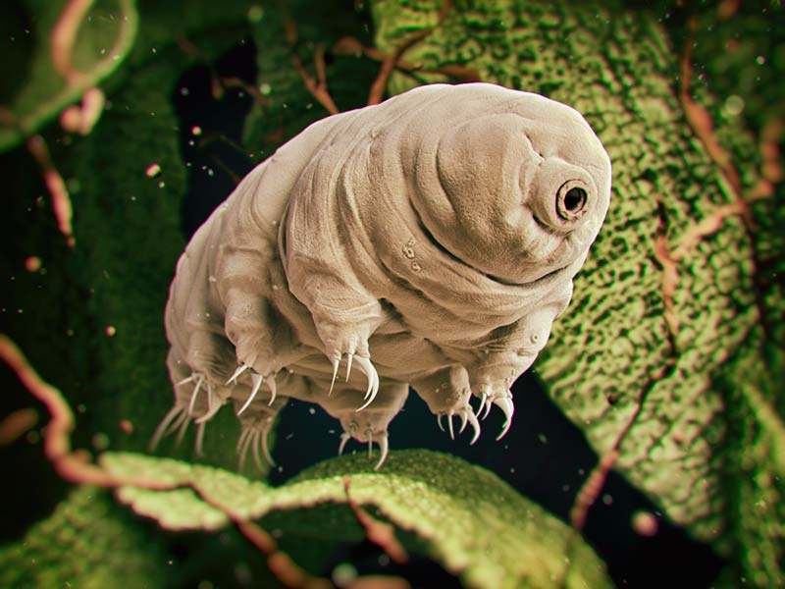
Tardigrade

Slide 74
Do not edit How to change the design
你覺得人類生命從何時開始？
The Slido app must be installed on every computer you’re presenting from

Slide 75
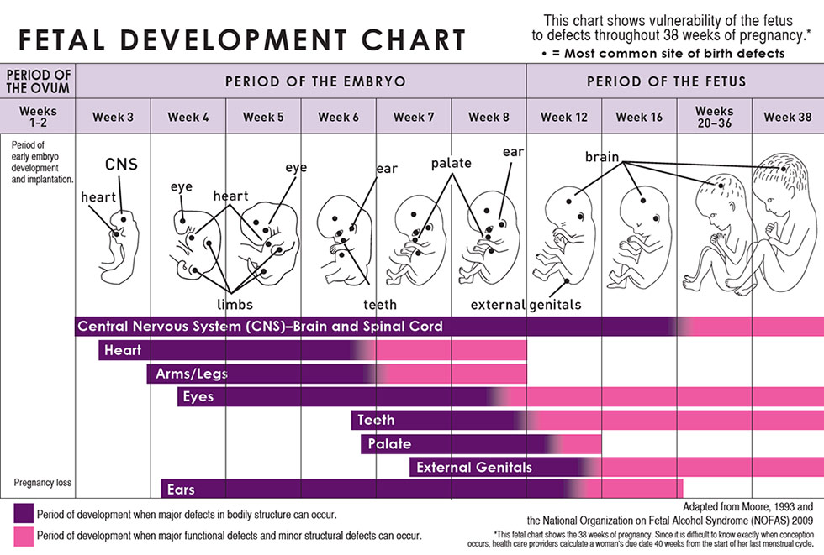
台灣優生保健法施行細則第 15 條第 1 項規定，如果有依照優生保健法實施人工流產的話，要在妊娠 24 週內實施才合法

Slide 76
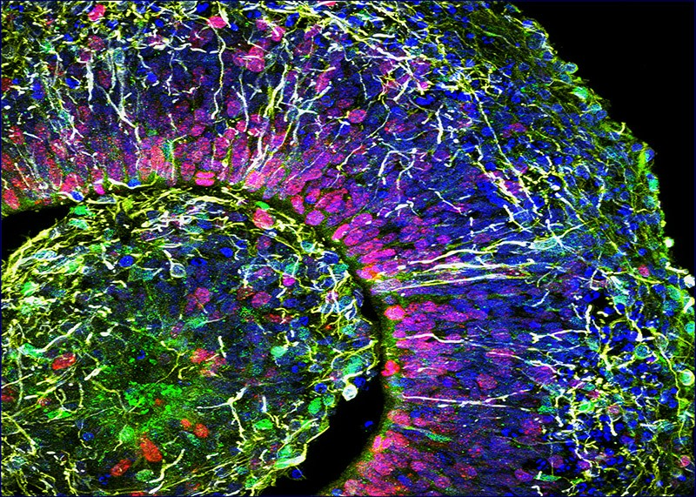


Neural organoids

Slide 78


作者引領讀者踏上生物學最前線，探索透過改變生理機能延壽的最新研究，也省思死亡的科學與哲學議題：
生命自有定數，不可強求？
死亡有其必要生物學目的？
試圖永生又要付出什麼社會和道德成本？
諾貝爾化學獎得主拉馬克里希南省思死亡的科學與哲學
分享對衰老和死亡科學的開創性探索

Slide 79

The oldest person for whom we have reliable records was a French woman named Jeanne Calment, who died in 1997 at age 122. She smoked for all but the last five years of her life and ate more than two pounds of chocolate every week.

Slide 80
Already, humans live twice as long as we did 150 years ago due to increased knowledge about diseases and their spread. Does that suggest interventions to triple or quadruple our lifespan lie just around the corner?

Slide 81
Do not edit How to change the design
你覺得人類的平均壽命還會再大幅增加嗎？
The Slido app must be installed on every computer you’re presenting from

Slide 82

Do not edit How to change the design
Audience Q&A
The Slido app must be installed on every computer you’re presenting from

Slide 83



新生課程前測問卷填答說明
研究目的
了解新生課程對大一同學學習與適應的影響
問卷分為「前測」與「後測」兩階段，作為課程成效分析依據
填答對象
問卷普發給生醫院全體大一同學
研究倫理聲明
自願參與：您可自由決定是否填答，不會影響課程成績與任何學校權益
資料保密：所有答案將匿名處理，僅用於學術研究與課程改進，不會洩漏個人資訊
時間需求：填寫約 10 分鐘
聯絡方式：若有疑問，請與研究團隊聯繫（exalt@my.nthu.edu.tw）
填答回饋
凡完成前測問卷者，可獲得探索學習中心 飲料提袋一個
凡於學期結束時完成後測問卷者，可獲得 50元便利店禮券 乙份
發送方式：完成填答問卷後向助教出示填答完畢即可
新生課程前測問卷
填答網址

